Slide 1


MSU Dual Credit Mission
Connecting high school students to higher education in earning college credit with access and affordability.
Helping Students Gain
a Head Start on their Future.
Fall 2026

Slide 2
Dual Credit Staff
Whitney Hoodenpyle
Administrative Assistant
General Support, student accounts
Part time (M-F, 8am-12)
Melissa Tolleson
Administrative Specialist III
Billing, Instructor builds, Parent/ Student Support
MTolleson@MissouriState.edu
Stephanie Van Rhein
  Associate Director
  Instructor Credentialing/Support, Class verifications, Grade support, Technical & Web support
  SVanRhein@MissouriState.edu
Jaime Ross
Director
Oversee Program Operations & Communications, Onboarding schools, Data & Workflows, MOU contracts
JaimeRoss@MissouriState.edu
Office Hours
Mon-Fri 8am to 5pm
417-836-3254
Dual Credit Webpage

Slide 3

Training Focus/Talk Points
Updated, more Streamlined Workflow & Important Information
  Specifically with freshmen & sophomore students
MSU will utilize the State DC/DE Scholarship - Identifying these students in DualEnroll
Tuition fee
  It will be $75/ credit hour starting this fall
  This information has been provided to the school principal and superintendent
Student Account Creation best practices
Early Student Applications
  before the end of the 2nd to 3rd week of classes
Yellow Action Items on your DualEnroll dashboard as these are your “action items”
Drop Dates and Drop Form Submissions
Viewing of the entire registration process
Where to find support
Q & A

Slide 4
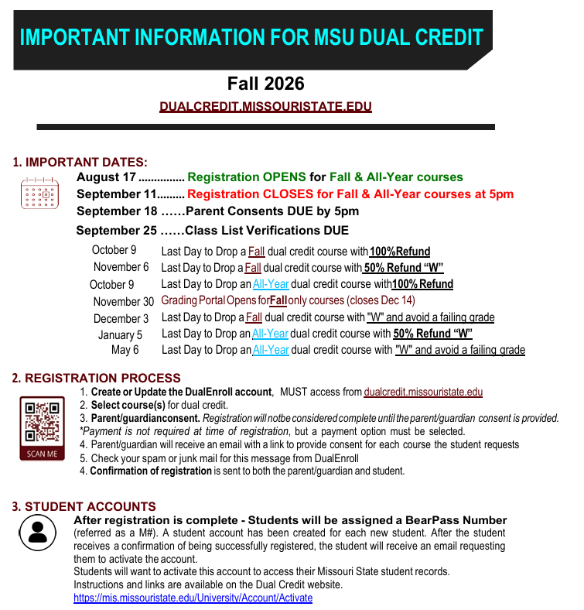

NOTES:
This is a short open registration time
  We are requesting that students complete the course registrations in their classroom in a timely manner.
The close date is a hard close!
  We do not accept late registrations unless it was an error on our part or a break in the workflow
    Our offices are open Monday-Friday, 8-5 to answer questions and support schools, students, and parents during the registration period
    Notifications are sent to students with incomplete applications to support their registration
    Out of fairness and equity to all, we will hold the same deadline standard to all individuals
If a student “Drops” the dual credit portion or moves
  We request that a Drop Form be completed and signed by you and returned to our office
  We will update our files appropriately and apply the drop refund schedule

Slide 5
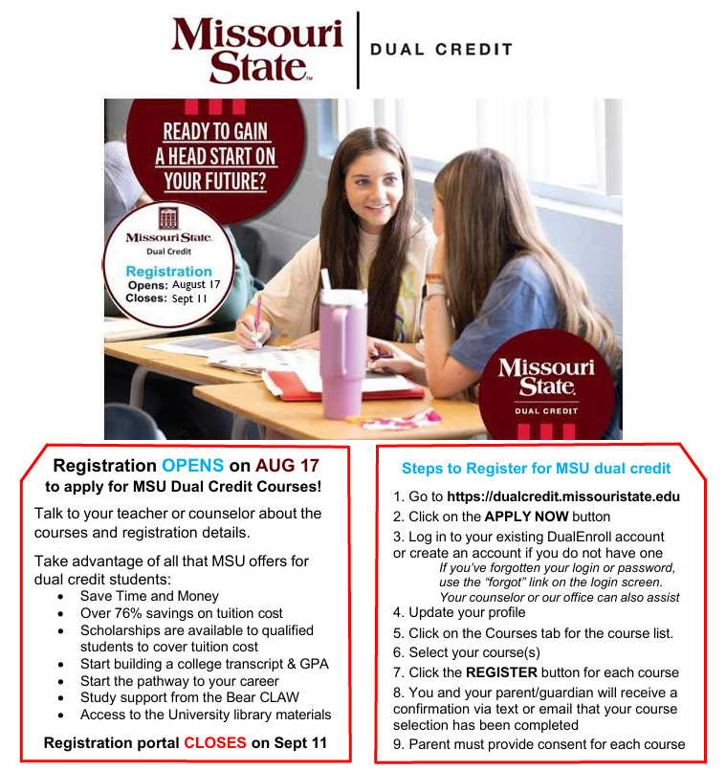

NOTES:
This is part of the E-packet that is available to you for download
  These packets can be found in the Partner school resources tab on our website
    Information for Counselors/Site coordinators
    Important Dates, Flyer, Checklist, Student Registration Guide, DE Steps, State DE/DC Scholarship Info, Why MSU dual credit
This is a great flyer to share out with instructors, parents, and students
  Includes all the important information/resources for registration into MSU dual credit courses
Please refer a student or parent to our office if they have questions
  We are available and return calls/messages
  We may have extended hours and planning some Saturdays to support student registrations.
    Once we get this time scheduled more information will be provided and posted on our website

Slide 6
Important Information
Student Account Creation
  Must start from the MSU login portal for Missouri State dual credit courses
  Only create a new account if they have never created an account in DualEnroll
  Do NOT create a new account in DualEnroll if the student
    created a previous DualEnroll account from a past semester
    created a DualEnroll account with another college or university
  Highly recommend using personal email (not school) in creating the account
B. Promote Early Applications (before the end of the 2nd to 3rd week of classes)
1. Can drop course(s) early with no consequences and full refund (Fall course, by Oct 9)
    Ensures parent receives communication about the availability/registration for the dual credit course(s)
    Ultimately the parent/guardian has control to approve or deny the registration
2. Complete before they get so busy in the school events
3. Helps to support instructor verification of student participation and class list verifications
4. Allows for edits/changes to be made before registration closes
5. Provides more time for the parent/guardian to complete the required consent
C. ACT scores are Not required, but can be used for student eligibility
D. Parent consent is required for each course before the student can be registered into the course
Note the deadline for this to be completed
You can see students at this step which holds the registration process
You can also see the notifications/nudges sent to both the student and parent/guardian
E. Note any Yellow Action Items on your DualEnroll dashboard as these are your “action items”

Slide 7
Continued Policies for Fall 2026
More Streamlined Workflows
  The registration of all freshmen & sophomore students will no longer require High School Choose Test Scores step
    These applications will go directly to a registration file after the High School Approve student participation step is completed
    These students will be registered into the course after the parent/guardian consent is completed
  b) High School Choose Test Scores step will be required for all ENG 110/210, Math, & Physics courses
    Existing Test Scores Meet Course requirements
      No extra qualifying information is needed
    Additional Test Scores Required
      Used to submit an ACT or placement score
We are No longer offering the MSU FRL Scholarship
  We will be utilizing the State DC/DE Scholarship for this benefit
  Information, links, and support will be offered by our office
    A landing page is available on our webpage with links and information about this scholarship
    This will be a payment option for parent/guardian to select while providing consent
    Our office will monitor those who completed the state scholarship application and follow up as needed
  This is the same program used by the other dual credit providers in Missouri
  Students/families complete 1 application that will cover all dual credit courses taken from all approved state providers
    Student/parent must select MSU as a provider of their dual credit/dual enrollment course(s)
  There is no limit on the number of credit hours which The State Scholarship can also be applied to dual enrollment courses
Tuition cost is $75 per credit hour

Slide 8
RE: School Site Coordinator Action
The following actions will be required for the dual credit student application to move forward. Please complete these steps to ensure that a student’s application is processed in a timely manner.
If a student did not select a counselor during their registration, you can
  Select View all students to see every student from your school that has a pending application.
If a student selected the wrong counselor, you can click on the student’s name and update the counselor selection so they will appear on your dashboard.
Under the counselor drop down, select All Counselors to see all students from your school
Steps for completing a student dual credit registration:
High School Approve Student Participation (this must be completed for all students)
  Open your MSU DualEnroll dashboard
  Click on this action step which will be highlighted in yellow
    This is the only action required to complete most student registrations
    This process can be completed in Batch mode (good if there are 5 or more to complete at one time)
      Click Yes, if the student is eligible and enrolled in the corresponding HS course
      Click No, if student is Not eligible or not concurrently enrolled in the HS course
        This will close the student registration for the course
  Select Complete Step
High School Choose Test Score (only required for ENG 110/210, Math, and Physics course registrations)
  Click on this action step which will be highlighted in yellow
    Click Yes, if the student is eligible and concurrently enrolled in the HS course or
    If qualify scores are visible and meet course eligibility requirements
      It would be awesome if you would record the ACT scores if the student has them available!
  Select Additional Test Scores Required if
    Qualifying test score(s) are not recorded or showing
      i.e. ACT score or placement exam
  Select Complete Step

Slide 9
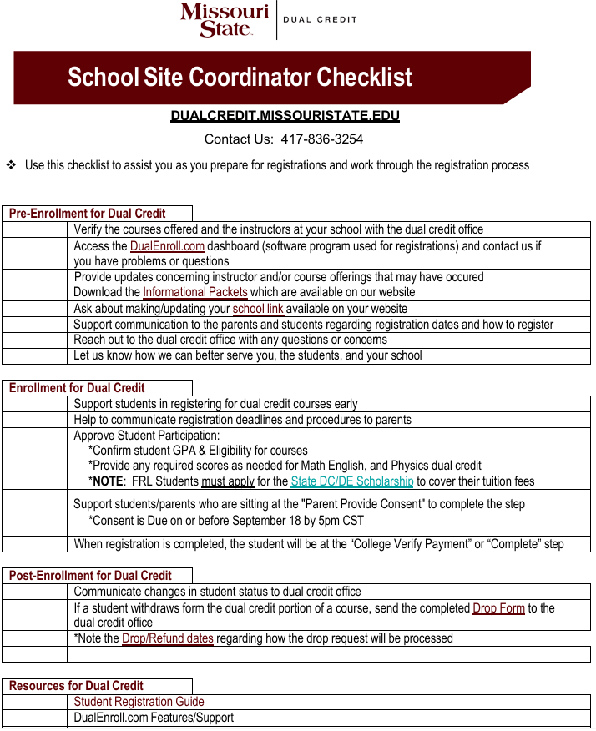
Notes:
Please contact our office if you have any questions. We are available Mon-Fri from 8-5pm.
We will support the parents as much as possible for the State Scholarship
  There will be an option for them to select this payment option when they provide consent.
Drop forms must be completed, signed by the counselor, and returned to our office to be processed.
Please let us know if a student
  Drops the course for DC
  Moves from the district
  Has an event that will impair them from completing the course

Slide 10
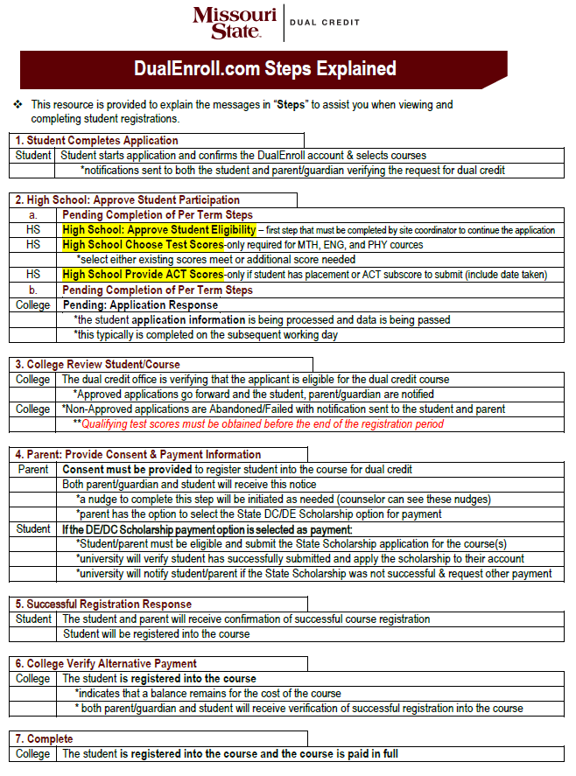
Notes:
The registration process is a multi-step workload:
  Student completes the application
  Data is pass-backed with an M#
  HS approves student
  Registration file is generated and approved
  Parent Provides Consent *****
  Student is registered into the course
These steps will appear on your dashboard, and you can view the history of each step
You can “Abandon” a student registration if the student should not be in the dual credit course
Communications are sent to both the student and parent/guardian for each step.

Slide 11
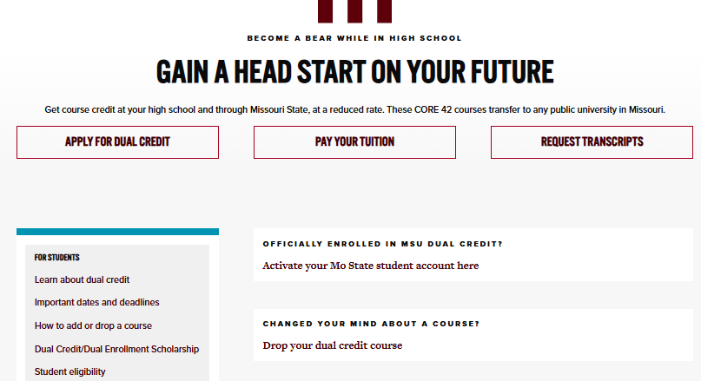

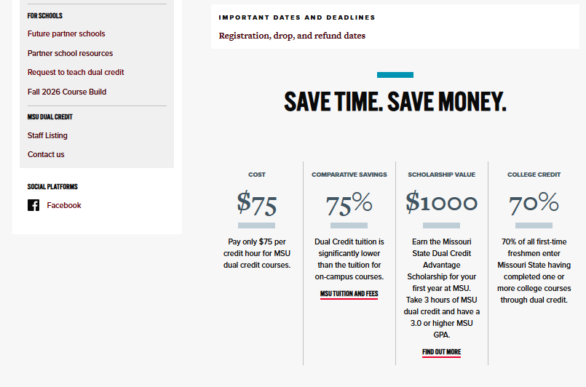
Missouri State University Dual Credit
https://dualcredit.missouristate.edu
Where to go for:
Student Registration
Access to DualEnroll
Your school dashboard
Parent/School support
School Course listings
Important Dates/Forms
General information
Contact information

Slide 12
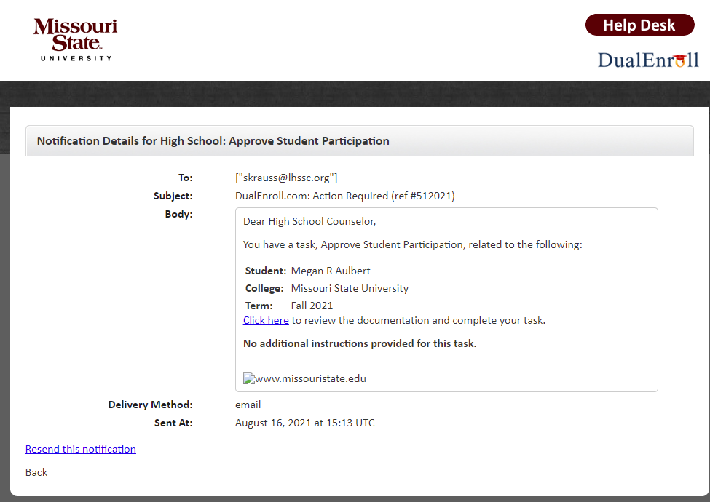
Counselor Notification

Slide 13
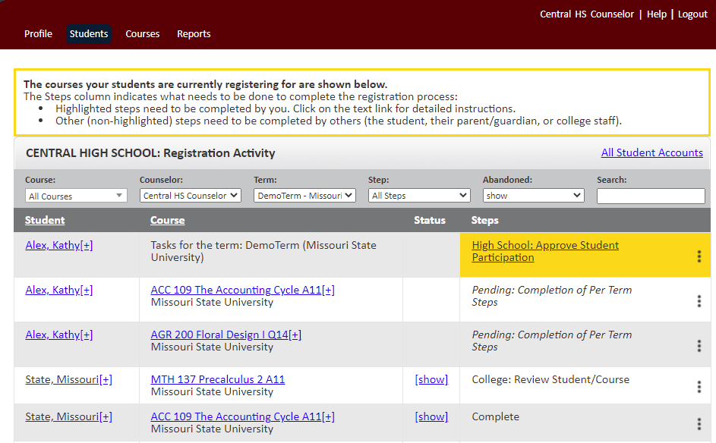
Counselor Dashboard https://missouristate.dualenroll.com/login

Slide 14
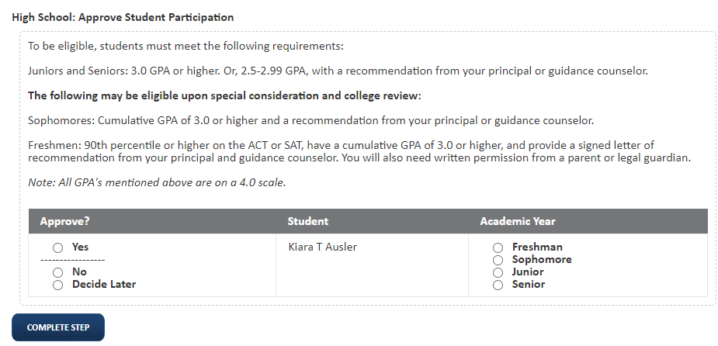
High School: Approve Student Participation
To be eligible, you must meet the following requirements:
Juniors and seniors: 3.0 GPA or higher. Or, 2.5-2.99 GPA, with a recommendation from your teacher or guidance counselor.
The following may be eligible upon special consideration and college review:
Sophomores: Cumulative GPA of 3.0 or higher and a recommendation from your guidance counselor.
Freshmen: A recorded qualifying ACT/SAT score or a cumulative GPA of 3.0 or higher, and a recommendation from your guidance counselor.
Note: All GPA’s mentioned above are on a 4.0 scale.
First, MI, Last
*This is completed one time for each student
*not for each specific course they are wanting
*There is a second tier of approval for students selecting Math and English courses, or if the student is a freshman or sophomore requesting dual credit
Notes:
Make academic year drop down
Change GPA to text input field

Slide 15
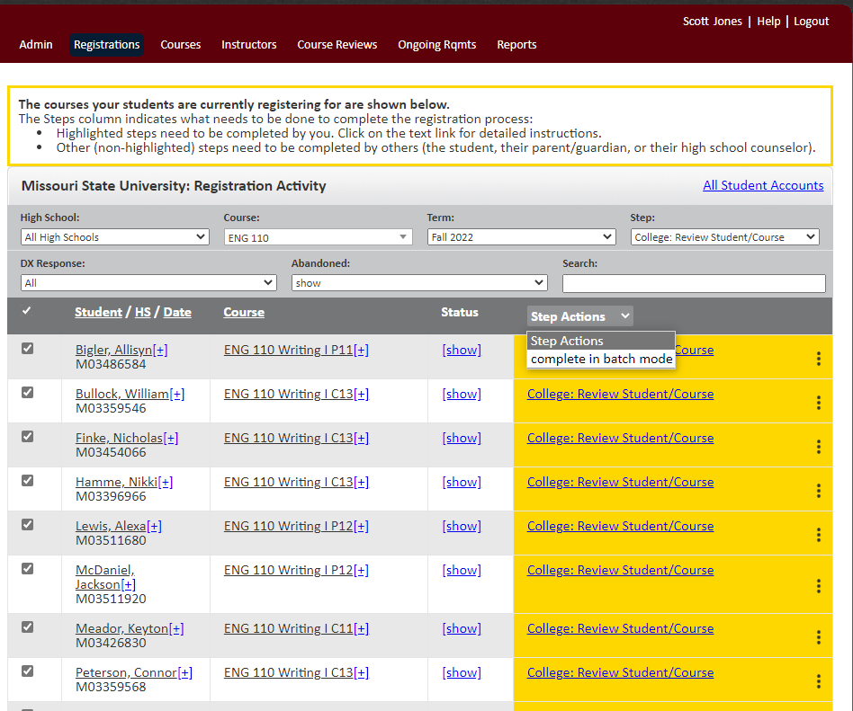
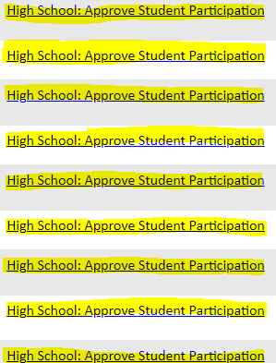
High School: Approve Student Participation
Batch Mode
Notes:
Make academic year drop down
Change GPA to text input field

Slide 16
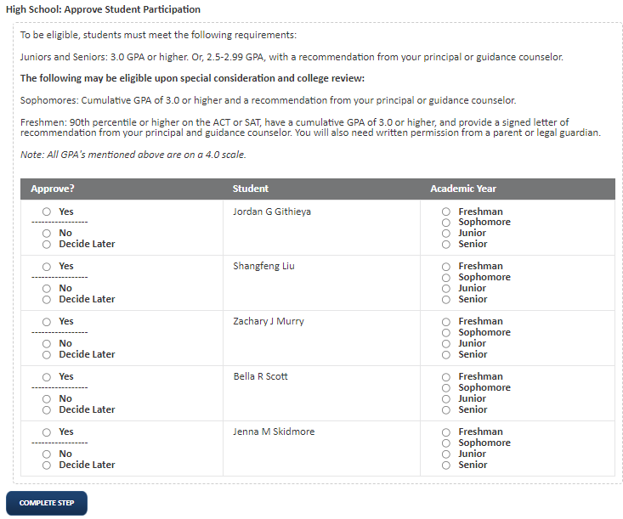
High School: Approve Student Participation
Batch Mode
Student Name
Student Name
Student Name
Student Name
Student Name
Notes:
Make academic year drop down
Change GPA to text input field

Slide 17
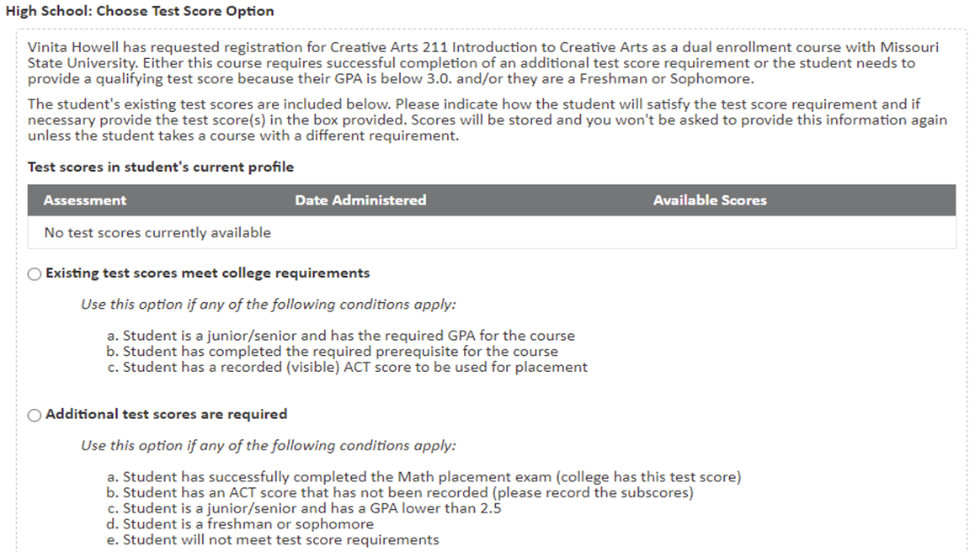
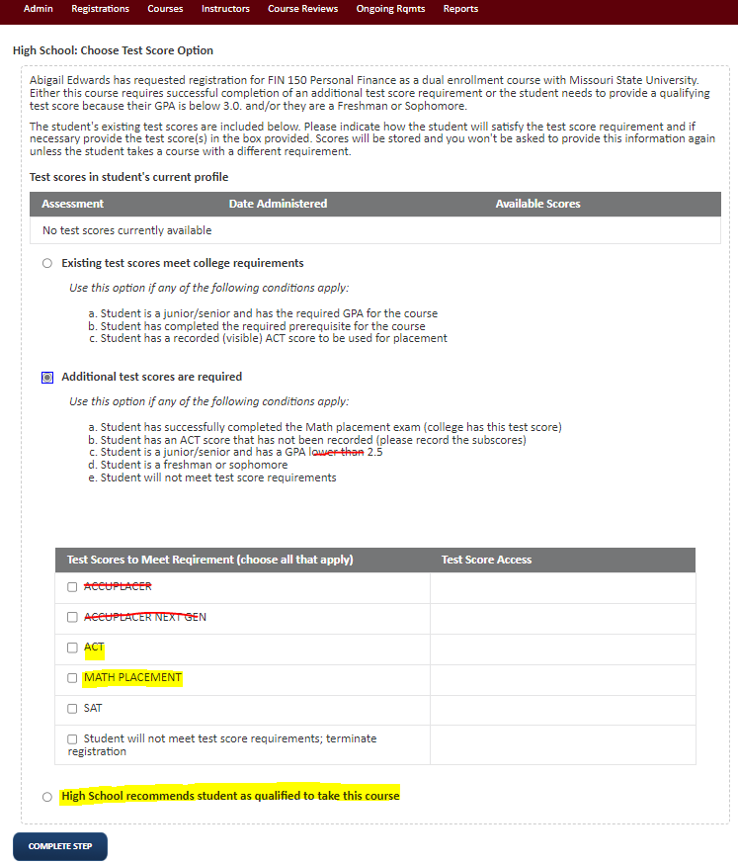
High School: Choose Test Scores
Only if ENG 110/210, MTH, or Physics courses

Slide 18
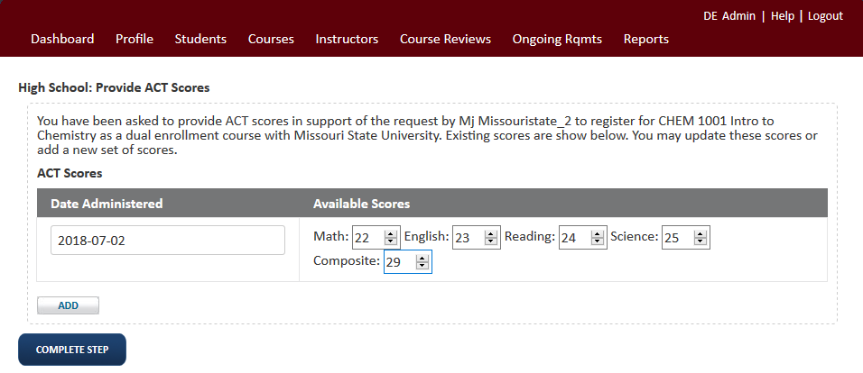
High School: Provide ACT Scores
Only if ENG 110/210, MTH or Physics courses
**A date administered must be included to complete this step
**Only the ACT subscore for the course (MTH, ENG) needs to be recorded

Slide 19
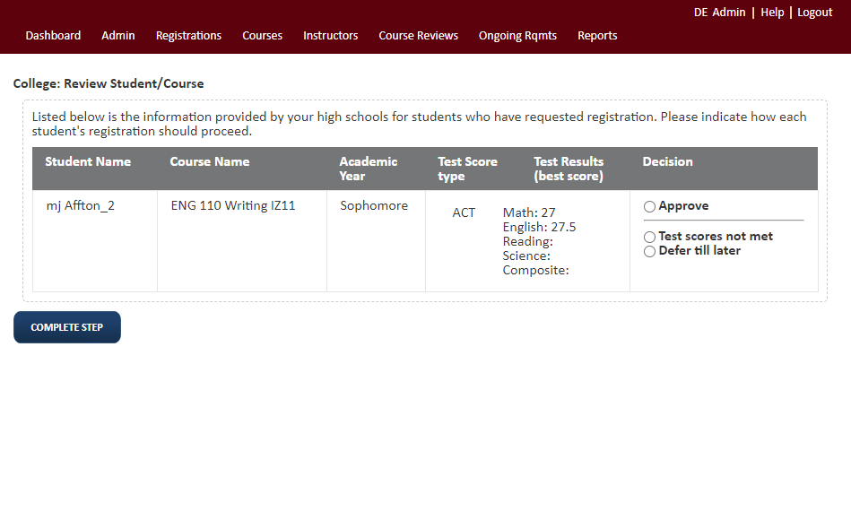
College: Review Student/Course
Only if ENG 110/210, MTH or Physics courses

Slide 20
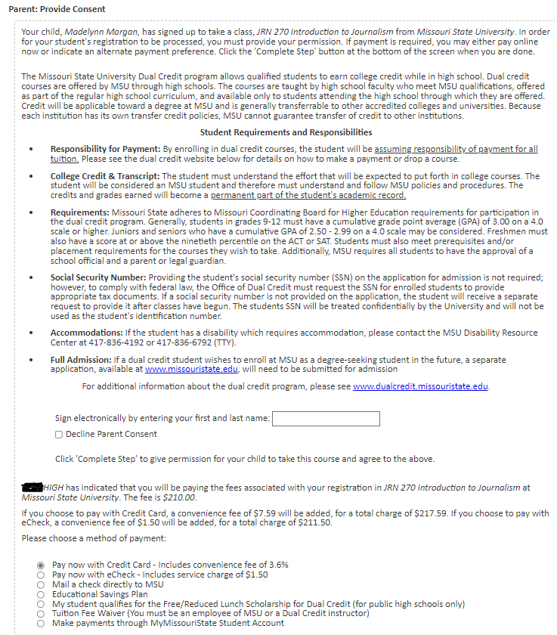
DC/DE Scholarship
Dual Credit/Dual Enrollment Scholarship-
High school students may qualify for state financial aid to cover the cost of their dual-credit courses!
The Dual Credit/Dual Enrollment (DC/DE) Scholarship from the Missouri Department of Higher Education & Workforce Development (MDHEWD) is a great way to begin your college journey for free!
The application is available electronically from the Journey to College web page or the State Financial Aid Portal.
Note this scholarship is operated and funded by the state, Missouri State University has no control over the application process or awarding of the scholarship.
An application must be completed with Missouri State University listed as a dual credit provider for the dual credit course(s).
For more information:
Department of Higher Education & Workforce Development
DCDE Fact Sheet
email: dcde@dhewd.mo.gov.
Notes:
Add “my parent works at MSU or is a dual credit instructor” question up front to bypass payment

Slide 21
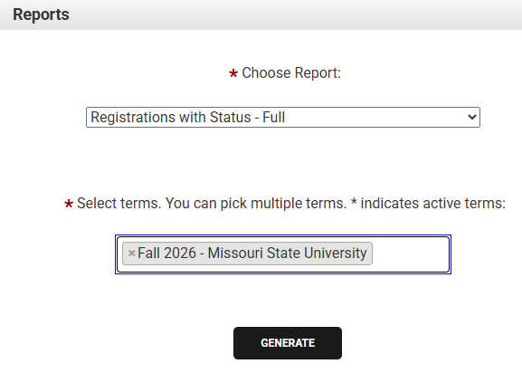
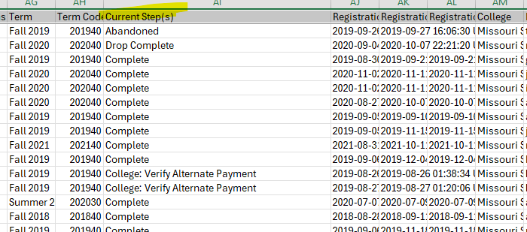
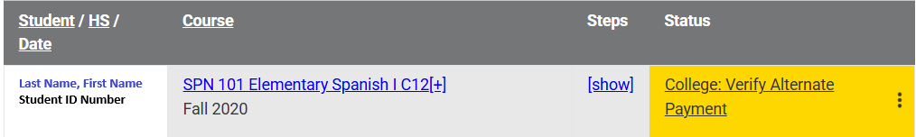
Identifying DC/DE Scholarship Students
Counselors may download Excel files of data under the “Reports” tab in DualEnroll. (See right)
Students who have selected DC/DE Scholarship as an intended method of tuition payment will show at the “College: Verify Alternate Payment” step after parent consent is complete. (See below)
Students who were at “College: Verify Alternate Payment” and are moved to “Complete” = Student has been verified by our office staff in the system, and his/her Dual Credit course(s) is covered for the term.
Feel free to reach out to our office directly if you need a list of student from your high school site who are listed in the State Scholarship portal. We are happy to look up individual students, if needed. Contact: Stephanie Van Rhein (Associate Director Dual Credit, SVanRhein@MissouriState.edu)
Increased communication to students that select scholarship will be sent from our office via email, text messaging, phone calls. Refer students with questions to our office for assistance (DualCredit@MissouriState.edu / 417-836-3254.

Slide 22
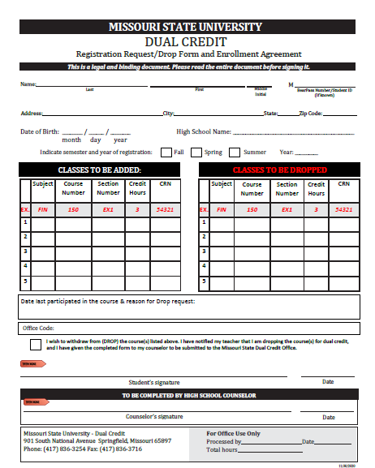
Dual Credit Student Drop Form
*A Drop form must be completed and received by the dual credit office for dual credit course drops.
There are 3 Drop Schedules:
1. 100% Refund
Fall course- Oct 9
Full Year course- Nov 13
Spring course- March 12, 2027
2. 50% Refund with “W”
Fall course- Nov 6
All Year course- Feb 5, 2027
Spring course- April 9, 2027
3. Drop/Withdraw with “W”
Fall course- Nov 6
All Year course- May 6, 2027
Spring course- May 6, 2027

Slide 23
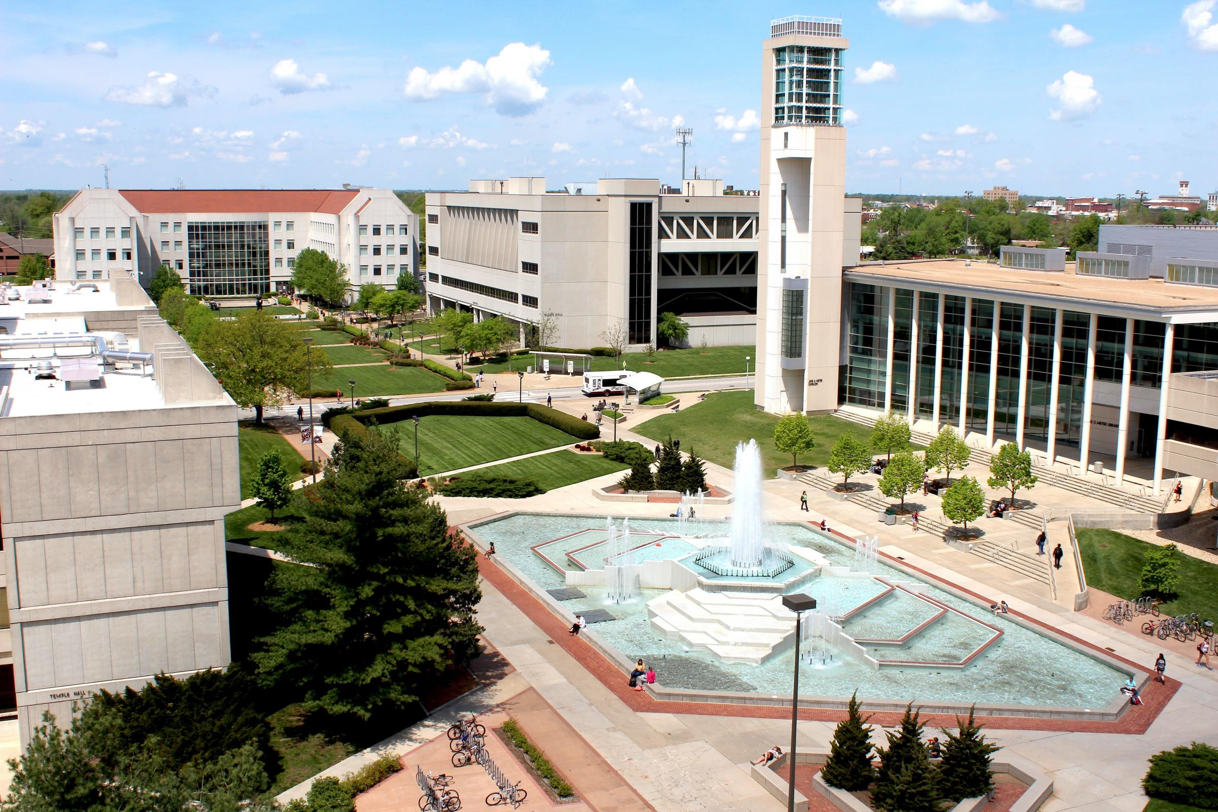
Thank you for your time in reviewing this important informational/training document. I hope this meeting was informational and helpful for you. If you have any questions or need support, please reach out to us. We are available Monday-Friday from 8am to 5pm to help support you, the parents, and students.
We are looking forward to the new fall semester and supporting our partners, families, and students.

